Slide 1
Agent Pipelines and Frameworks
Group 1

Slide 2
MLGym: A New Framework and Benchmark for Advancing AI Research Agents Deepak Nathani, Lovish Madaan, Nicholas Roberts, Nikolay Bashlykov, Ajay Menon, Vincent Moens, Amar Budhiraja, Despoina Magka, Vladislav Vorotilov, Gaurav Chaurasia, Dieuwke Hupkes, Ricardo Silveira Cabral, Tatiana Shavrina, Jakob Foerster, Yoram Bachrach, William Yang Wang, Roberta Raileanu https://arxiv.org/abs/2502.14499 21 Feb 2025
Presenter: Yorbis Daniel Alarcon (C0941168)
Notes:
A New Framework and a new Benchmark for Advancing AI Research Agents.
This work bring us closer to building autonomous research agents that can plan, test, and improve scientific experiments

Slide 3
Introduction and Motivation
Context → Why do we need AI research agents?
Scientific progress is slow and costly
LLMs can help automate repetitive research tasks
But we need frameworks to test and train these AI research agents
Motivation → Why MLGym?
A framework to train and evaluate LLM-based research agents
Works like a Gym for AI research tasks
Supports multiple domains: NLP, vision, RL, game theory
Includes a benchmark called MLGym-Bench
Notes:
¿Why do we need AR research Agents?
Scientific research is very expensive, takes a lot of human effort, and progress can be slow.
And, additionally,
Large Language models can help automate repetitive parts or research,
So, Why MLGym…
Because LLMs need a standardized environment to be trained and evaluated. A kind of Framework to be more precise.
Finally,
MLGYm is designed exactly for acting like a GYM for AI Research Agents… Supporting multiple domains and including a robust benchmark.

Slide 4
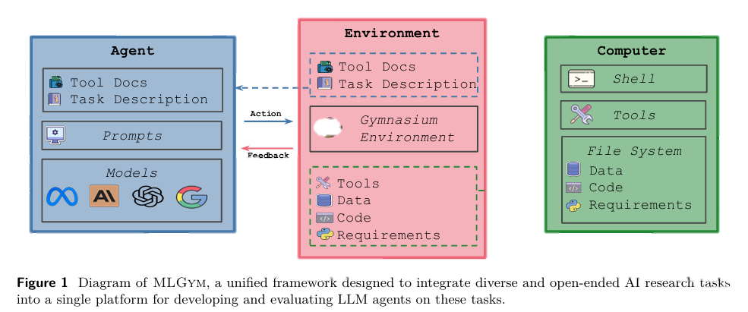
Architecture Overview
Agent → The brain (plans and executes commands)
Environment → The lab (a secure workspace in Docker)
Tasks → The experiments (the challenges to solve)
Datasets → The data to work on
Tools → Extra abilities (like file search, editing)
Reason → Take Action → Evaluate → Adjust → Repeat
Notes:
About the Architecture Overview…
the Architecture is divided into multiple parts…
Where one of them is the Agent, that is like the brain… This brain plans, decides and executes commands,
Then, there is the Lab or Environment, where experiments are run, using Docker for security and reproducibility.
Tasks are also part of the Architecture, and they are like the experiments themselves
Datasets that provide the materials. And finally…
Tools like *Search or *File Editing, that help the agents to have more abilities.
This separation of elements makes MLGym very modular and easy to extend
How does this interaction work?
The Agent analyzes the task, reviews documentation, and generates a command… For examples→ READING A FILE… MODIFYING A CODE
Then in the Gymnasium Environment, the system evaluates whether the command worked or not… and returns the result to the agent (Feedback).. And the Agent adjusts its decisions based on that feedback.
It creates a loop of → Reason – Take Action – Evaluate – Adjust – Repeat
(The computer is the “executor” of the commands - where the agent’s actions are actually carried out,)

Slide 5
MLGym Components
Agent | LLMs with a memory module for long tasks, integrated through an agentic harness for consistent evaluations
Environment | Gym interface running in a Docker container with secure permissions and reproducibility
Datasets | Local or HuggingFace datasets, mounted read-only for data integrity and reproducibility
Taks | Defined by flexible YAML config files, evaluated with domain-specific artifacts beyond simple metrics
Notes:
NOW LET’S BREAK DOWN EACH PIECE:
The Agent is POWERED by LLMs, with a memory module for long tasks, and is connected through an agentic harness to standardize evaluation…
Agentic harness refers to a FRAMEWORK or INTERFACE that connects the LLM to the environment… It is like a Bridge… between the LLM and the tools, data and task. Thanks to this, researchers can swap in different LLMs (Gemini, Claude…) while keeping everything else the same
The Environment uses Docker and the Gym interface, with secure permissions and reproducibility. This means that every time a task is run, it’s like starting a fresh, locked-down lab environment where the agent can only access the tools and data it is supposed to.
They use Isolated Containers, which are like giving the agent its little mini-computer (for experiments and reproducibility)
Datasets come from local or HuntingFace sources, mounted read-only to protect them… Protect them from modifications or accidental corruption
For example, the data is protected in case the agent wants to overwrite it
Tasks are defined with flexible YAML configurations and evaluated with domain-specific artifacts beyond simple metrics such as F1 Score or Accuracy..
In fact they develop a metric called AUP (Area Under Performance). A metric that we will explain later on.

Slide 6
Tools and Memory Module
Agent tools for smarter research
File editor, validator, and search tools available as command-based interactions via the Agent-Computer-Interface (ACI)
Memory module saves and retrieves configurations using JSON-based semantic embeddings
Literature retrieval through Semantic Scholar API plus optional PDF parsing support
Supports long-horizon tasks beyond normal context length by enabling persistent memory
Notes:
In this environment, AI agents get extra tools for smarter research, such as:
File editor, a validator, and search commands, all built into the ACI – Agent Computer Interface
There is also a Literature retrieval tool through the Semantic Scholar API
AND…
The memory module uses JSON-based semantic embeddings to store and retrieve information… acts like a Digital Notepad… Helping the Agent work on Long Tasks without forgetting.
That is critical for research pipelines due to experiments go beyond a single conversation.

Slide 7
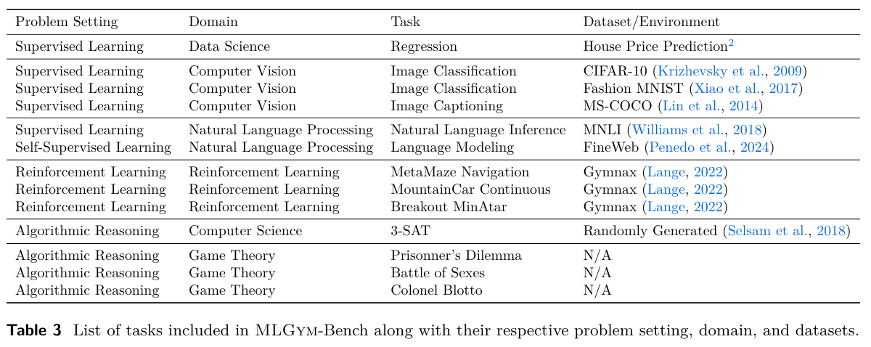
MLGym-Bench
Bechmark Overview:
13 diverse, open-ended research tasks covering multiple domains
Includes NLP, Computer Vision, Reinforcement Learning, Game Theory, and Data Science
Uses domain-specific evaluation artifacts (not only simple metrics) to test Baseline improvement skills (Level 1)
Supports standardized evaluation pipelines for fair comparison across different models
Notes:
Benchmark inside the MLGym environment, called MLGym-Bench…
This Benchmark includes 13 diverse, open-ended tasks that cover multiple domains such as Image Classification or Regression.
Each Task uses domain-specific evaluation artifacts to test agents more deeply… SO for example, for the NLP Domain, they have F1 Score, for RL, reward Functions, for Computer Vision, classification accuracy.
With all of that, this Benchmark helps to compare different models under the same conditions.

Slide 8
Agent Capability Levels
How MLGym evaluates the intelligence of its agents? - how smart or capable an AI agent is
Reproduction: Repeats existing results
Baseline Improvement: Improves on existing solutions
State-of-the-Art Achievement: Matches top human benchmarks without access to external SOTA references
Novel Scientific Contribution: Invents new algorithms worth publishing
Groundbreaking Scientific Contribution
Pursues long projects, discovers new paradigms
Level 0
Level 1
Level 2
Level 3
Level 4
Level 5
The agent is able to reason.
The agent can safely explore and adjust solutions
Notes:
MLGym uses a levels framework to classify Agents' skills…
So
At Level 0, agents only reproduce results.
At Level 1, agents improve baselines, which means they improve existing solutions… for example, they improve codes… They can reason, safely explore, and adjust solutions.
At level 2, Matches top human available results, without access to them.
At level 3, Agents can invent new algorithms worth publishing
At level 4, Agents can define the next state of the art… which means they can make discoveries that can change our understanding of problems
Finally, at Level 5, Agents pursue long projects, discover new paradigms. Which means… find new ways of thinking
Most of these models only reach LEVEL 1

Slide 9
Some Benchmark Tasks
Data Science
CV
NLP
House price prediction
Image classification (to be shown in demo)
Language inference
Game Theory
Reinforcement learning
Prisoner’s Dilemma, Battle of Sexes
Games like Breakout, MountainCar
Notes:
Here are some Specific tasks used in MLGym-Bench.
For Data Science for example, we have a House Price prediction
For Computer Vision, they have an image classification task that will be shown later on in the Demo part.
NLP uses language inference
For Reinforcement Learning, there are Games Like Breakout, Mountain Car

Slide 10
How Benchmark Tasks Are Evaluated
Domain-Specific Metrics
Uses NLP scores, RL rewards, or classification accuracy depending on task
Evaluation
Custom Evaluation Artifacts
Python scripts or strategy functions check the agent’s solution
Reproducibility & Fairness
Read-only datasets, same conditions for every model
Notes:
Tasks in MLGym are evaluated in a very detailed way… So
First, each domain uses its metrics, such as the F1 score for NLP, as we already mentioned before
Second, each task has its own Python script to check the agent’s answer
Finally (Third), datasets are read-only to guarantee the same test conditions for everyone, ensuring fair comparisons

Slide 11
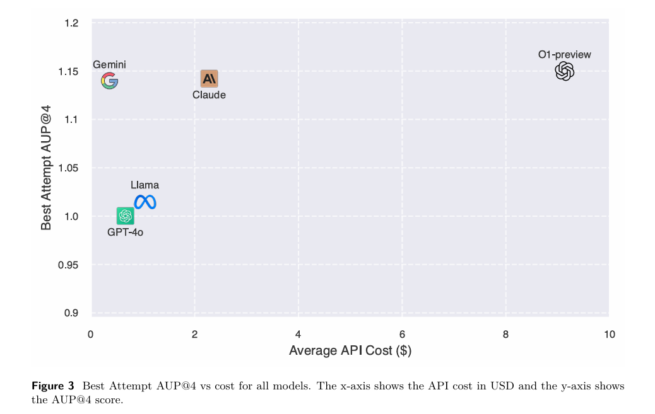
Results: Model Performance vs. Cost
Compares AUP (Area Under Performance) score vs. API cost
Higher AUP = better performance on benchmark tasks
O1-preview achieved the best AUP but is most expensive
Claude and Gemini balanced good scores with reasonable cost
GPT-4o and LLaMA had lower costs but only baseline improvements
Models also differed in exploration patterns, with some submitting faster while others explored more actions
Notes:
This chart compares models on their Area Under Performance score versus API cost.
Higher AUP means better performance
AUP → AUP, or Area Under Performance, summarizes how much an agent improves over time compared to the baseline across its steps.
That’s Why,
O1-preview is at the top of the chart. had the best performance
However, Gemini reaches almost the same AUP and costs ten times less. Claude also shows a good relationship between performance and cost

Slide 12
Demo
Bringing MLGym to life
Notes:
Now let’s move to a practical demonstration of MLGym in action… We will focus on the image classification task using the CIFAR-10 dataset, which is a common benchmark with 10 categories of images.
Left side → System prompt: Goal is to maximize accuracy on the test set within 50 steps.
60K images – 50K reserved for testing
After analyzing the baseline, the agent proposes improvements: Adding more layers, batch normalization, increasing epochs, etc…

Slide 13
Discussion & Limitations of MLGym
Current models mostly reach only Level 1 (baseline improvements)
No mature evaluation metrics for measuring true creativity or scientific novelty
Provides a reproducible, extensible framework for fair benchmarks
Struggles with higher-level research goals like novelty and creativity
First open-source “gym” for training and evaluating research-focused agents
Lacks advanced memory or structured to support long-term
Notes:
About the Discussion and Limitation, there are two fundamental limitations, which are
Current models mostly reach only level 1 (baseline improvements – The Agent can understand, process, and improve existing solutions), no more than that
No mature evaluation metrics for measuring true creativity have been created.
Advantages:
First open-source GYM for AI Agents
Provides extensible frameworks

Slide 14

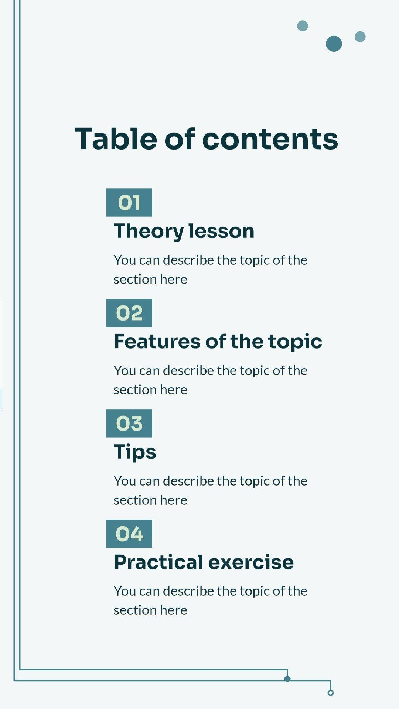
Takeaways
MLGym = a flexible, modular framework
Supports evaluating and training LLM agents
Opens the door for future autonomous research agents
Promotes standard benchmarks for fair comparison
Encourages research on agent autonomy, reasoning, and collaboration
Thanks!
Notes:
To wrap up, MLGym is a flexible, modular framework to train and benchmark LLM agents. It supports different tasks, evaluation metrics, and encourages research on agent community.

Slide 15
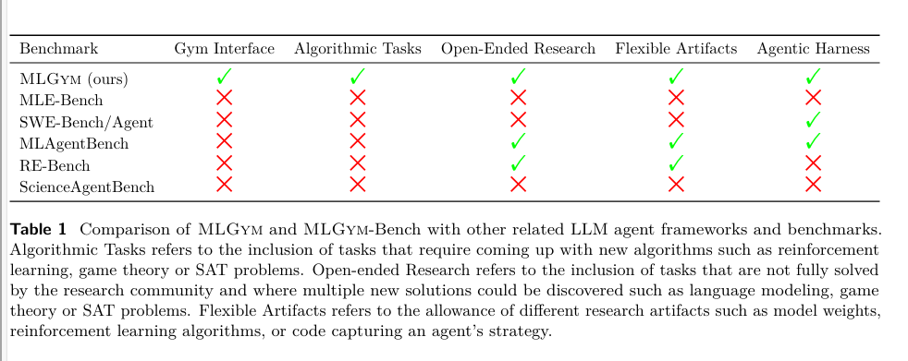
Comparison

Slide 16
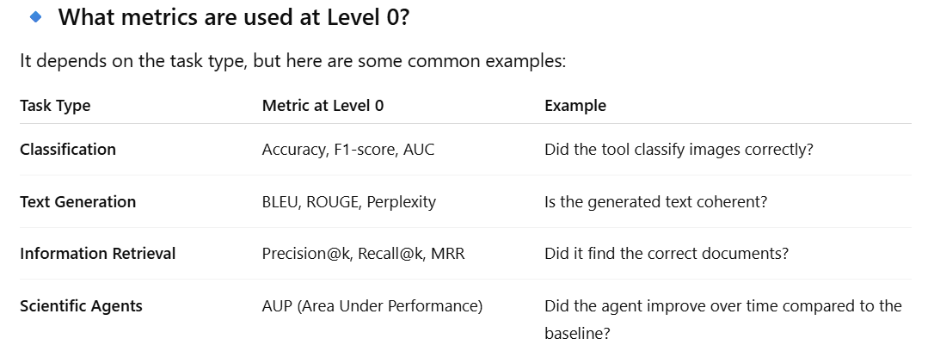

Slide 17
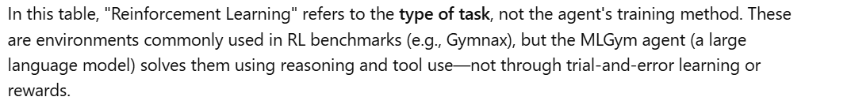
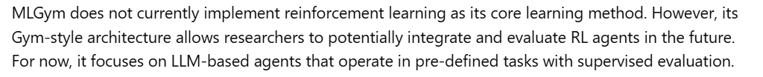
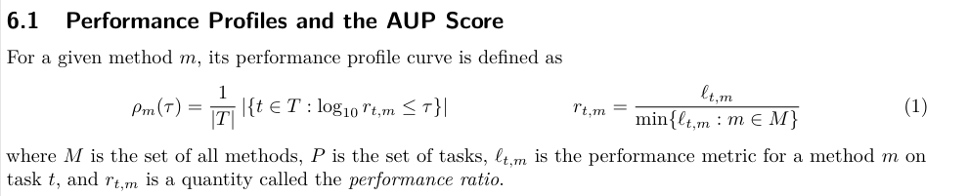
Area Under Performance, summarizes how much an agent improves over time compared to the baseline across its steps.

